Slide 1
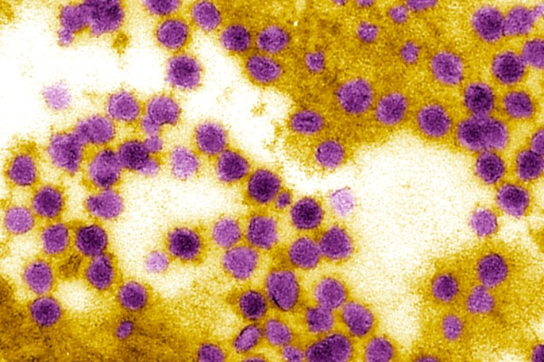





Building Computational Models to Understand The Interplay Between Climatic Factors, Air, Transportation, and Infectious Disease Dynamic
April 20, 2024
NIH R01AI168144 (Mihaljevic PI)
By Olivia Vester
Mentor: Dr. Kayode Oshinubi
Notes:
Hello! My name is Olivia Vester and I am here today to present the work I completed under my mentor Dr. Kayode Oshinubi. This project is entitled Building Computational Models to Understand The Interplay Between Climatic Factors, Air, Transportation, and Infectious Disease and reflects just a portion of a larger research framework relating to disease dynamics.

Slide 2
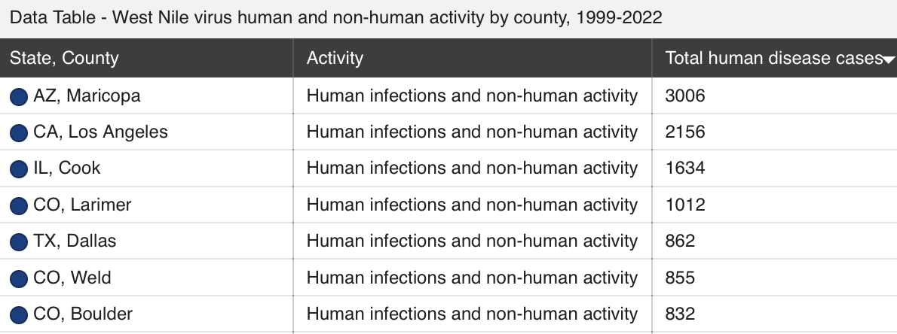

Background:
Maricopa County is consistently in the top 10 counties yearly in the nation for West Nile Virus; from 1999-2022 it has the most cases in the nation
Centers for Disease Control and Prevention 2023
1
Notes:
The West Nile Virus is a mosquito borne disease that affects horses, birds, and humans. When contracted by humans, the development of the illness can happen in a few different ways; A majority of the people who contract WNV do not experience any symptoms but those who do, often experience an illness similar to the common flu. However, according to the CDC, 1 in 150 infected individuals develop more severe cases that cause neuroinvasive infections like encephalitis and meningitis which can lead to serious complications and even death. Because of these risks, it is important to study when and where they may be most prevalent. Since AZ’s Maricopa County is the largest contributor of cases since the virus entered the United States in the late 90s, it is an significant area of study for identifying risk.

Slide 3
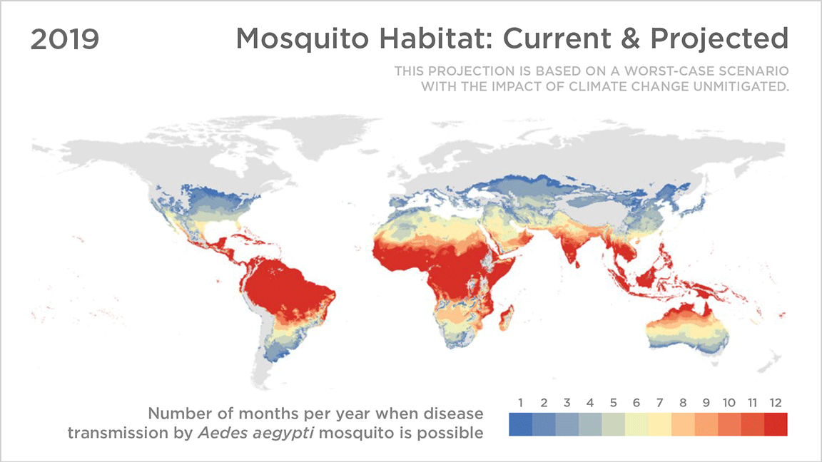
Relevance:
2
Ellis 2019
Notes:
Though the basis of this project is centered around disease dynamics and targeting risk to humans, a considerable factor in this data is climate. As we all know the Earth’s climate is changing due to a large number of a reasons and as a result of that the Earth itself is changing. This visual reflects how mosquito dynamics, and subsequently West Nile Virus dynamics are projected to change in the next 30 and 60 years. This is in the interest of NASA for climate research and these projected changes that show an increase in disease transmission from mosquitos due to the changing climate is an informational data point that can contribute to a further understanding of climate change.

Slide 4
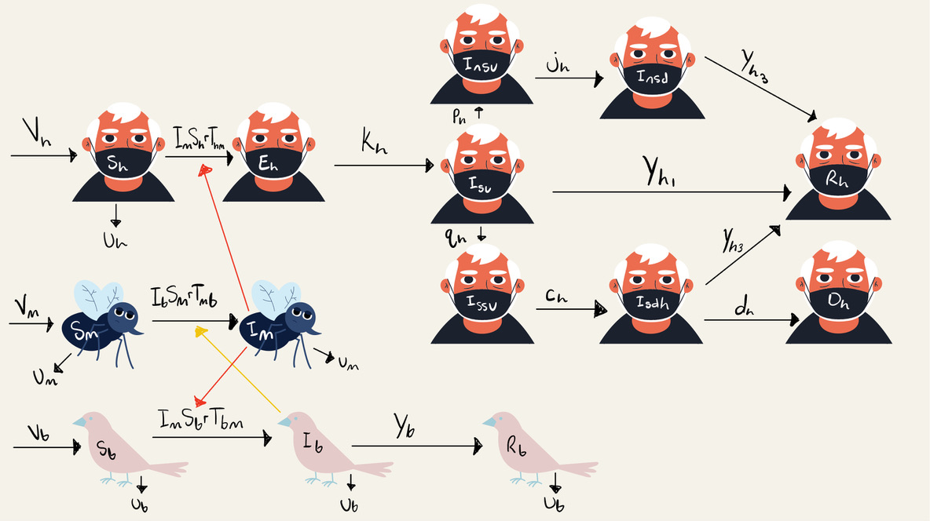
So…what’s the main point?
3
Notes:
To help identify these risks to humans, we want to create models that account for climate, space, and time because bird and mosquito dynamics are a factor of climate. Climate varies across space and time so making a model at the county level can help target more precise predictions. To build these models, a new software system called Epymorph is to be used. Epymorph is a Python system within the broader project of Epidemiological Modeling Resources of Public Health that can produce these mathematical models. The models are based on equations withdrawn from this visual that connects the human, bird, and mosquito dynamics. From this chart, 3 main equations emerge that lay a basis for the predictive data. Using the box and arrow plot, intrapopulation models can be created to make this data graphical. As for the data I am presenting today, I am using the equations for birds and mosquitoes. The key transitions here are susceptible to infected mosquitoes and susceptible to infected to recovered birds.

Slide 5
Methods:
Runnable
Modeling
Experiment
(RUME)
MM
🚗
✈️
🚶
IPM
GEO
S
I
R
<data>
Simulation
Engine
Output
prevalence
incidence
Parameters
sim.run(date,duration)
S I R
. . .
. . .
. . .
. . .
S🡢I I🡢R R🡢S
. . .
. . .
. . .
. . .
Initializer
<metadata>
4
Coles 2023
Notes:
In addition to the intrapopulation model code, there are other components that come into play for these models to be functional in the Epymorph system. The end goal for the modeling project is to get all three main components incorporated into the results. The components are the IPM (intrapopulation model), a geo, and a movement model. The IPM lays a base for the data to be simulated; it contains the event cases represented by the box and arrow plot on the previous slide. The geo component is essentially code that incorporates location data and can also include significant factors like temperature and precipitation. The movement model component adds in information about species travel and how the population in an area changes over a specific time period. In the data I am displaying, only the geo and IPM pieces are implemented as it is a step by step process with many working parts to get all factors included.

Slide 6
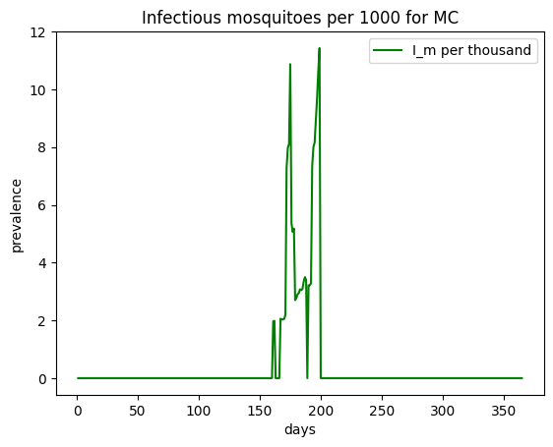
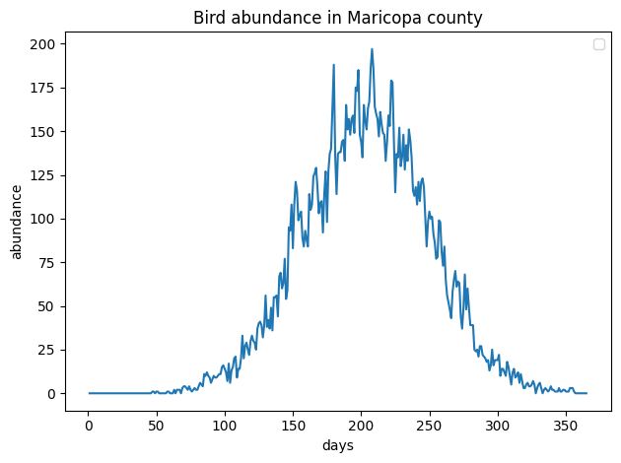
Simulated Species Abundance For 2014:
5
Notes:
Using the methods described on the previous slides, a number of simulations can be created that model different factors of the West Nile Virus. There are dozens of graphical outputs so the Epimorph team selected a specific few to discuss here as a display of the results. This particular graphs displayed on this slide are indicative of simulated data of the abundance of birds in Maricopa County during the year 2014 and the amount of infected mosquitoes per 1000 for that same year. Since this disease is mosquito borne, seeing the amount of infectious mosquitoes simulated within the county in a single year is necessary. The adjacent bird abundance data shows infectious birds counted in the area within 2014 as well. This pattern shows how the bird population changes throughout the year and that is has the highest infection level in the late summer.

Slide 7
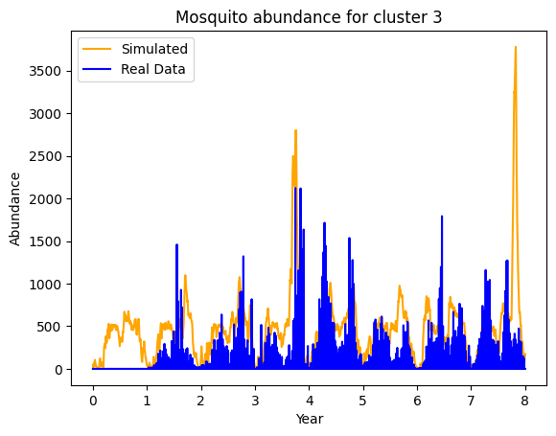
Results and Interpretations:
The success of the results of this project can be determined by how well the simulation results align with the reference materials
2006
2007
2008
2009
2010
2011
2012
2013
2014
6
Notes:
The prediction models created from this project are based of preexisting data from years past in order to compare how well the predictive modeling reflects real data. To show how the results of been successful thus far, I have selected a predictive model that displays the abundance of mosquitos in one of the geo clusters between the years 2006 and 2014 and the complementary real data from that time. As you can see, the models are very similar and thus the predictive methods appear to be successful.

Slide 8
Future Work:
The next steps for this project are well established; they are a continuation of making the models good predictive agents
7
Notes:
Looking at future work for this project, the next steps for these models include finishing up the human part of the model which is the intrapopulation model and its complimenting simulations which includes simulating human infection risk based on climate and adding movement to the models to complete the trio of components that create effective models and to complete all the parts of the project that the title “Building Computational Models to Understand The Interplay Between Climatic Factors, Air, Transportation, and Infectious Disease Dynamic” suggests.

Slide 9
Thank You!
NIH R01AI168144 (Mihaljevic PI)
Notes:
Thank you for your time!

